Slide 1
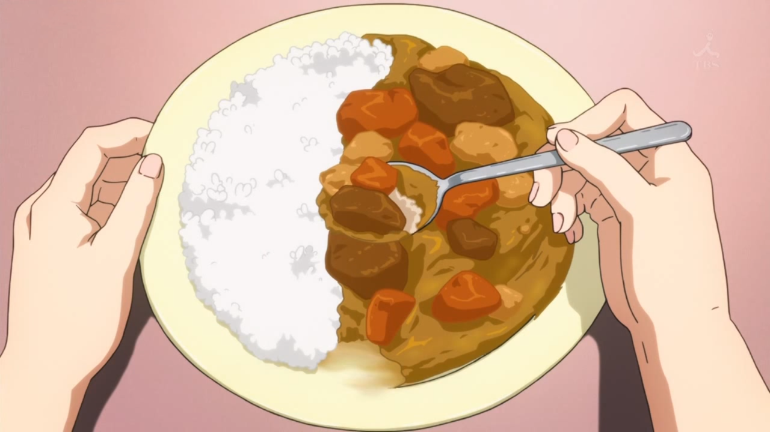
Japanese Curry in Theory And Practice
From Anime To Actual, With Detours Into History
(Photo from Amagi Brilliant Park, Episode 6)

Slide 2
So What’s Going On Here?
We hear about Japanese Curry all the time, we’ve probably even had it.
We’d like to make it, of course, and maybe do more than those store-bought sodium bombs.
So we’re going to learn about Japanese Curry, why it’s popular, its history, it’s place in pop culture, and of course how to make it!

Slide 3
Whom Am I And Why Am I Doing This?
I’m Steven Savage, an IT Program Manager who also writes and blogs on geek careers, creativity, and citizenship at StevenSavage.com, Informotron.com, and SeventhSanctum.com
In 2012 I realized I liked Japanese Curry and should learn to make my own. Since then I’ve been experimenting with different versions.
I love sharing cooking. I love curry. So I’m talking about it!

Slide 4
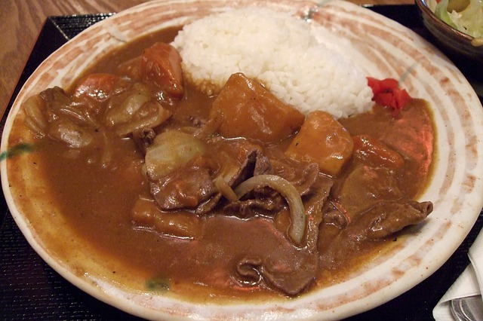
Japanese Curry In Culture
Omnipresent and Delicious

Slide 5
Japanese Curry - Everywhere
Japanese Curry is all over Japanese pop culture.
You can find it in anime from Those Who Hunt Elves to Black Butler. It’s in games like Xenosaga.
It’s even a major plot point in Cute Earth Defense Force, which you should immediately watch after this.
So what’s up with that?

Slide 6
There’s A Reason
Japanese Curry is popular in Japan. It’s in restaurants and in pre-made blocks. It’s everywhere.
Some restaurants jealously guard their own curry formulas, individual tastes are that important.
Almost every self-respecting home cook has their own personal recipe.
I’ve heard it said the average person in Japan wants to eat it once a week.

Slide 7
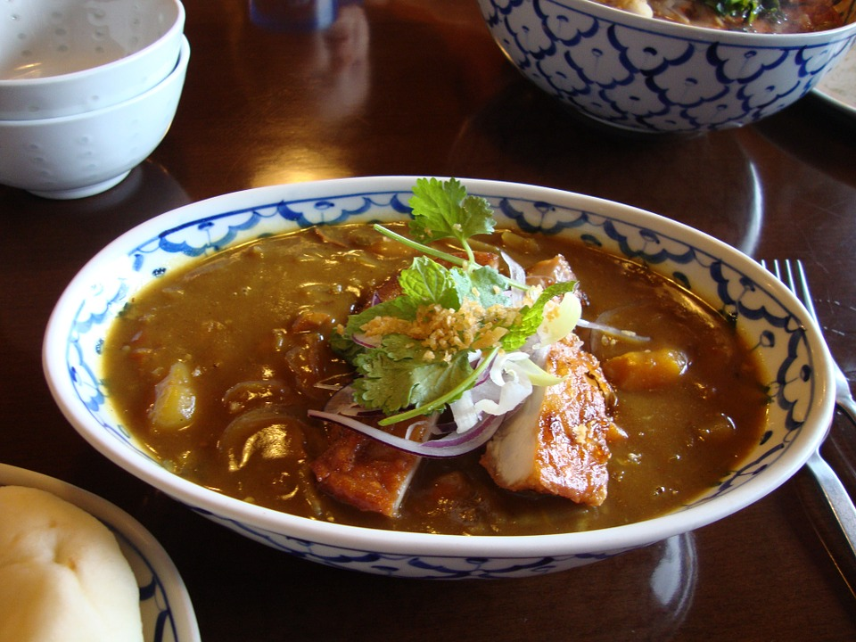
Japanese Curry – Secret Origin
OK it’s not secret, but run with me here.

Slide 8
Japanese Curry – Not Japanese
Japanese Curry started with the Japanese Navy – it adapted the British Navy’s curry, which in turn was based on Indian cooking. This seems to have happened around the early 20th century.
Stories vary, but it seems to have been adapted as it was easy to make or let you serve a big pile of nutritious food easily and deliciously. Or both.
To this day Japanese Curry is served once a week in the Navy, and ships often have their own recipes. It’s classically served with rice, a salad, and milk.

Slide 9
Curry Takes Japan
Japanese Curry spread into Japan from the navy.
My theory is this accelerated post-WWII.
This is not uncommon – a lot of Japanese “Soul Food” is repurposed Western dishes such as Okonomiyaki or Katsu
Chili is probably the closest Western equivalent.

Slide 10
So What Makes it “Japanese?”
It is a thicker curry, designed to go with rice – British Navy curry was thinner and soaked up with bread.
It usually uses popular Asian Curry Powders – S&B Curry being the most popular, and the one you should use.
It often involves a lot of different ingredients to get it “just right.”
It usually involves making a roux (butter, flower, and spices cooked together) to thicken broth.

Slide 11
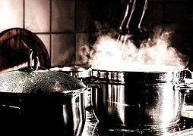
Basic Japanese Curry
Starting with the basics

Slide 12
There Are Two “Basic Japanese Curries”
The most popular form involves using roux:
Melt butter or equivalent in a pan.
Add flour and curry powder. Mix.
Cook it until brown and a bit crumbly on low heat.
Add to whatever broth you have.
Simmer until thick, stir with a wisk to break up the roux.

Slide 13
The Other Faster Method
Dump curry powder into broth.
Use a thickening agent.
  Cornstarch – stir some into a cup of cold broth, then add it to the boiling mixture. Fair warning, if you freeze it, it reheats as more of a gel.
  Arrowroot – stir some into a cup of cold broth, bring the rest of the broth to a boil, remove and when it stops bubbling, add the mix and stir.
This method has a less rich taste – cooking the roux adds flavor.

Slide 14
Nope that’s not it!
These are basic recipes. Starters.
Most Japanese curry involves more ingredients and is more complex.
Remember how I said everyone had their own version? This is when it gets crazy . . .

Slide 15
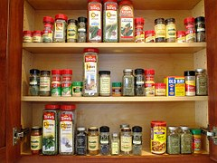
Japanese Curry: The Real Deal
Personalized, tasty, and at times totally crazy.

Slide 16
“Real” Japanese Curry
Almost all Japanese curry, from store-bought to personal, adds more ingredients to create richer tastes.
Ingredients can be divided by those that go in the roux, those that go in the broth – and those that substitute for them
A general rule is that unless it’s a lot of liquid, making a roux-based curry means new ingredients should start in the roux. It helps the flavors blend.

Slide 17
Things To Go In The Roux
Common additions include:
Soy sauce or Worcestershire sauce
Tomato paste or catsup.
Garlic (very popular)
Red pepper and black pepper
Fruits, jellies, and other mixtures.
Sometimes roux is made with caramelized onions.

Slide 18
Things In The Broth
Common additions include:
Fruits, jellies, or juices.
Wine (especially red wine)
Spices.
Cream.
Coconut milk.
Sometimes the broth is replaced with other things, like Daishi broth.

Slide 19
But there’s more!
People often add more unusual ingredients for richer flavors:
Coffee (popular in some Navy Curries)
Cheese
Other sauces like chutney
Brandy, sake, and other powerful fermented beverages.

Slide 20
It’s All Personal
If you’re going to learn to make your own Japanese Curry, there’s going to be a lot of experimentation involved.
My version took about 18 months to make, cooking it once a month, and I still tweak it.
I even invented a second version years later to make one that was fast and high protein.
I learned a lot a lot doing this and so can you!

Slide 21

Steve’s Curry Recipe – The First!
Obsession in a delicious saucy form

Slide 22
Steve’s Healthy Variant
The roux consists of:
  2 Tbsp organic, natural peanut butter
  ¼ cup oat flour
  2 Tbsp curry powder
  1/8 tsp red pepper powder
  1/8 tsp black pepper powder
  1 tbsp maple syrup
  3 Tbsp tomato paste (about 2.5 oz)
  2 Tbsp soy sauce (low sodium)
  2 Tbsp crushed garlic (6 cloves)
  2 ¼ tsp cocoa powder
For broth you’ll need:
  2 2/3 cups vegetable broth (home-made or low sodium)
  1/3 cup red wine

Slide 23
Making The Roux
Mix all of the above ingredients into a mass in an iron pot or a reliable no-stick one.
Cook on low heat, constantly scraping the sides. Flatten the roux, let it brown, scrape, repeat.
You want it to gradually turn a darker brown and gets a bit crumbly. This is sometimes called “The fox.”
It’ll be sticky (due to the peanut butter) but after awhile that decreases.

Slide 24
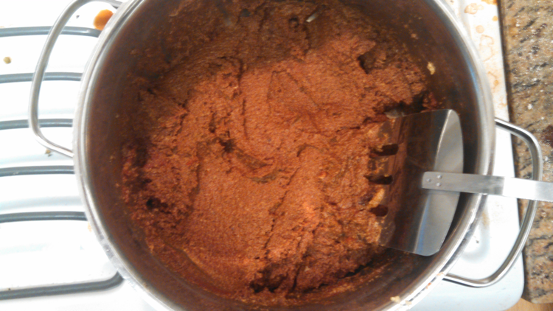
A Closer Look: Roux, Starting

Slide 25
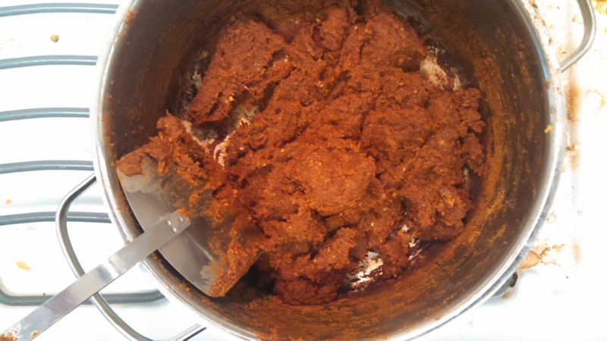
A Closer Look: Roux, Browning

Slide 26
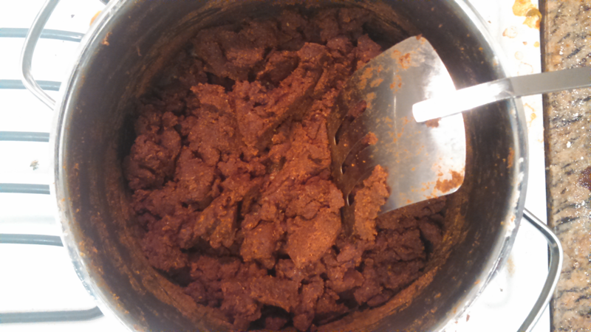
A Closer Look: Roux, Ready!

Slide 27
Add The Broth!
Then add 2 2/3 cups vegetable broth – I make my own. If you use broth with lots of salt in it you may want to remove one of the tablespoons of soy sauce.
Add 1/3 cup red wine along with the broth.
Turn up heat to a mild boil, stir constantly with a whisk, occasionally scraping the sides.
When the bubbles take a bit of effort to burst out, you’re done! Freeze it or serve!

Slide 28
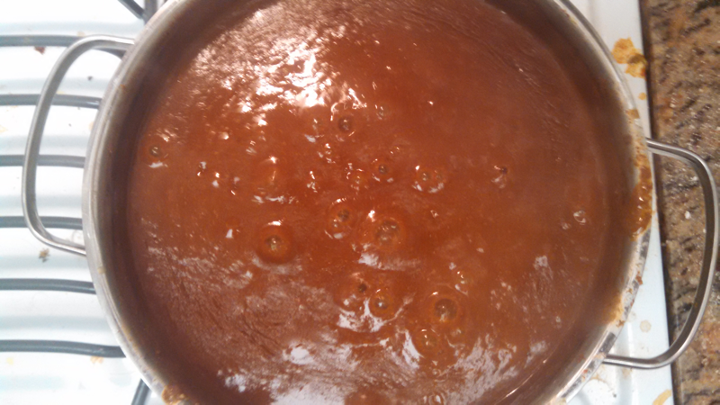
A Closer Look: Starting To Boil

Slide 29
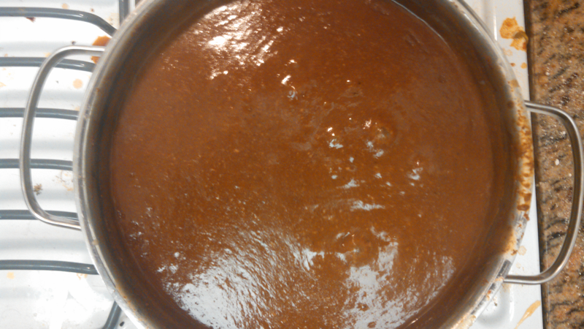
A Closer Look: Curry Ready!

Slide 30
How The Recipe Works
The recipe is a combination of many recipes and experimentation. It’s actually very traditional.
The soy sauce and tomato paste add savory flavors
The peppers add some heat.
Maple syrup, peanut butter, and wine add sweetness.
Cocoa powder adds a deep earthy taste.
Peanut butter blends the flavors – while being healthier than the alternatives – and adds oil for frying.

Slide 31
Scale And Time
Unfortunately this recipe can take up an hour to make – and the basics yield only 3-4 servings.
Fortunately you can scale this up and cook two, three, or even four times this amount with little extra time needed. I’ve cooked up to twelve servings that that took perhaps 90 minutes.
You can also boil vegetables and meat while someone stirs and use that broth – just dump the roux in!

Slide 32
Want To Try Fast?
Set aside ½ cup of broth.
Dump all the other ingredients together except the flour – leave that out.
Bring to a simmer and cook 20 minutes.
Mix the ½ cup broth with 4 Tbsp arrow root.
Remove pot from stove. When it stops bubbling, stir in arrowroot mixture.
Serve or package for freezing.
(Note I am still experimenting so this is a theoretical method).

Slide 33

My Next Curry Adventure
Curry 2: Electric Boogaloo, The Currying

Slide 34
Steve’s Fast And Full Variant
  1 Tbsp onion powder or a dry-sautéed onion.
  1 small butternut squash (about 2 pounds unpeeled), peeled, diced.
  2 tomatoes, diced.
  3 cups cooked garbanzo beans (2 14.5 oz cans)
  4 cups low-sodium vegetable stock
  2/3 cup red wine (shiraz and zinfandel are good)
  4 tablespoons curry powder.
  1/4 tsp cayenne pepper
  1/4 tsp black pepper
  1 tbsp maple syrup
  4 tablespoons soy sauce
  4 Tbsp crushed garlic
  4 1/2 tsp cocoa powder
  4 Tbsp peanut butter

Slide 35
How To Prepare This
Put everything in a pot. If using an onion, sauté it first, then add everything else.
Bring to a boil while stirring.
When the squash is very soft, mash it all with a potato masher.
Then blend it all together with an immersion blender, or let it cool and use a regular one.
Makes 6-8 servings.

Slide 36
How This Works
Beans add protein and filling fiber.
Squash, tomatoes, and beans give it body.
The soy sauce and tomatoes add savory flavors
Squash, maple syrup, wine, and peanut butter add sweetness.
Peanut butter blends the diverse flavors again.
Cocoa powder adds a deep earthy taste.

Slide 37
More About This Version
This was inspired by a thick Indian curry that I had at work, where it and some greens on rice made a meal.
I decided to make a “high protein” version to act as a protein serving as well as a curry.
It came together when I took inspiration from other experiments and Japanese curries that use pureed fruit.
It tastes a lot like my regular version, but is a bit thicker.
Careful reheating it, you can overcook it!

Slide 38
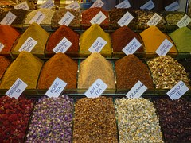
Making Your Own
No One Can Stop Curry Lord.
That’s you

Slide 39
So How Do You Make Your Own?
First, I’d try one of the basics, even though it may be pretty bland.
Next, try my “traditional” healthy version or my “fast and full”
Once you get the basics, get adventurous!
For extra fun, do this with friends to see what crazy stuff you can add!

Slide 40
Do Research
Go online. I found all sorts of recipes online – many of them personalized.
Read books. There are recipes scattered in various cookbooks.
Ask people. You never know what you’ll find.
Take what you find and start playing around!

Slide 41
How To Experiment
Take one recipe that you can make (such as a basic or one of mine) and modify it gradually. It may not hurt to try a completely different one now and then, but I found the evolving method works.
In general I’d recommend never doing more than adding AND subtracting one ingredient per “batch.”
You can “tweak” ingredients in a curry, but I’d never “tweak” more than one or two.
Add new ingredients to already made batches to get ideas.
Write down what you try.

Slide 42
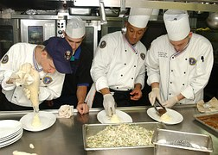
In Closing
You just listed to a guy talk about curry for nearly an hour.

Slide 43
Your Takeaways
Japanese Curry is the adaption of British Navy Curry.
It’s highly customized – like many adapted dishes.
There’s a few core concepts, especially the spices used and the use of roux.
The variants are wide-ranging.
Experimentation is key.

Slide 44
Your Next Steps
Go make a curry!
Share the results with friends!
Make more curry!
Keep at it until it’s right.
Tell people.
Tell me – www.stevensavage.com

